Slide 1

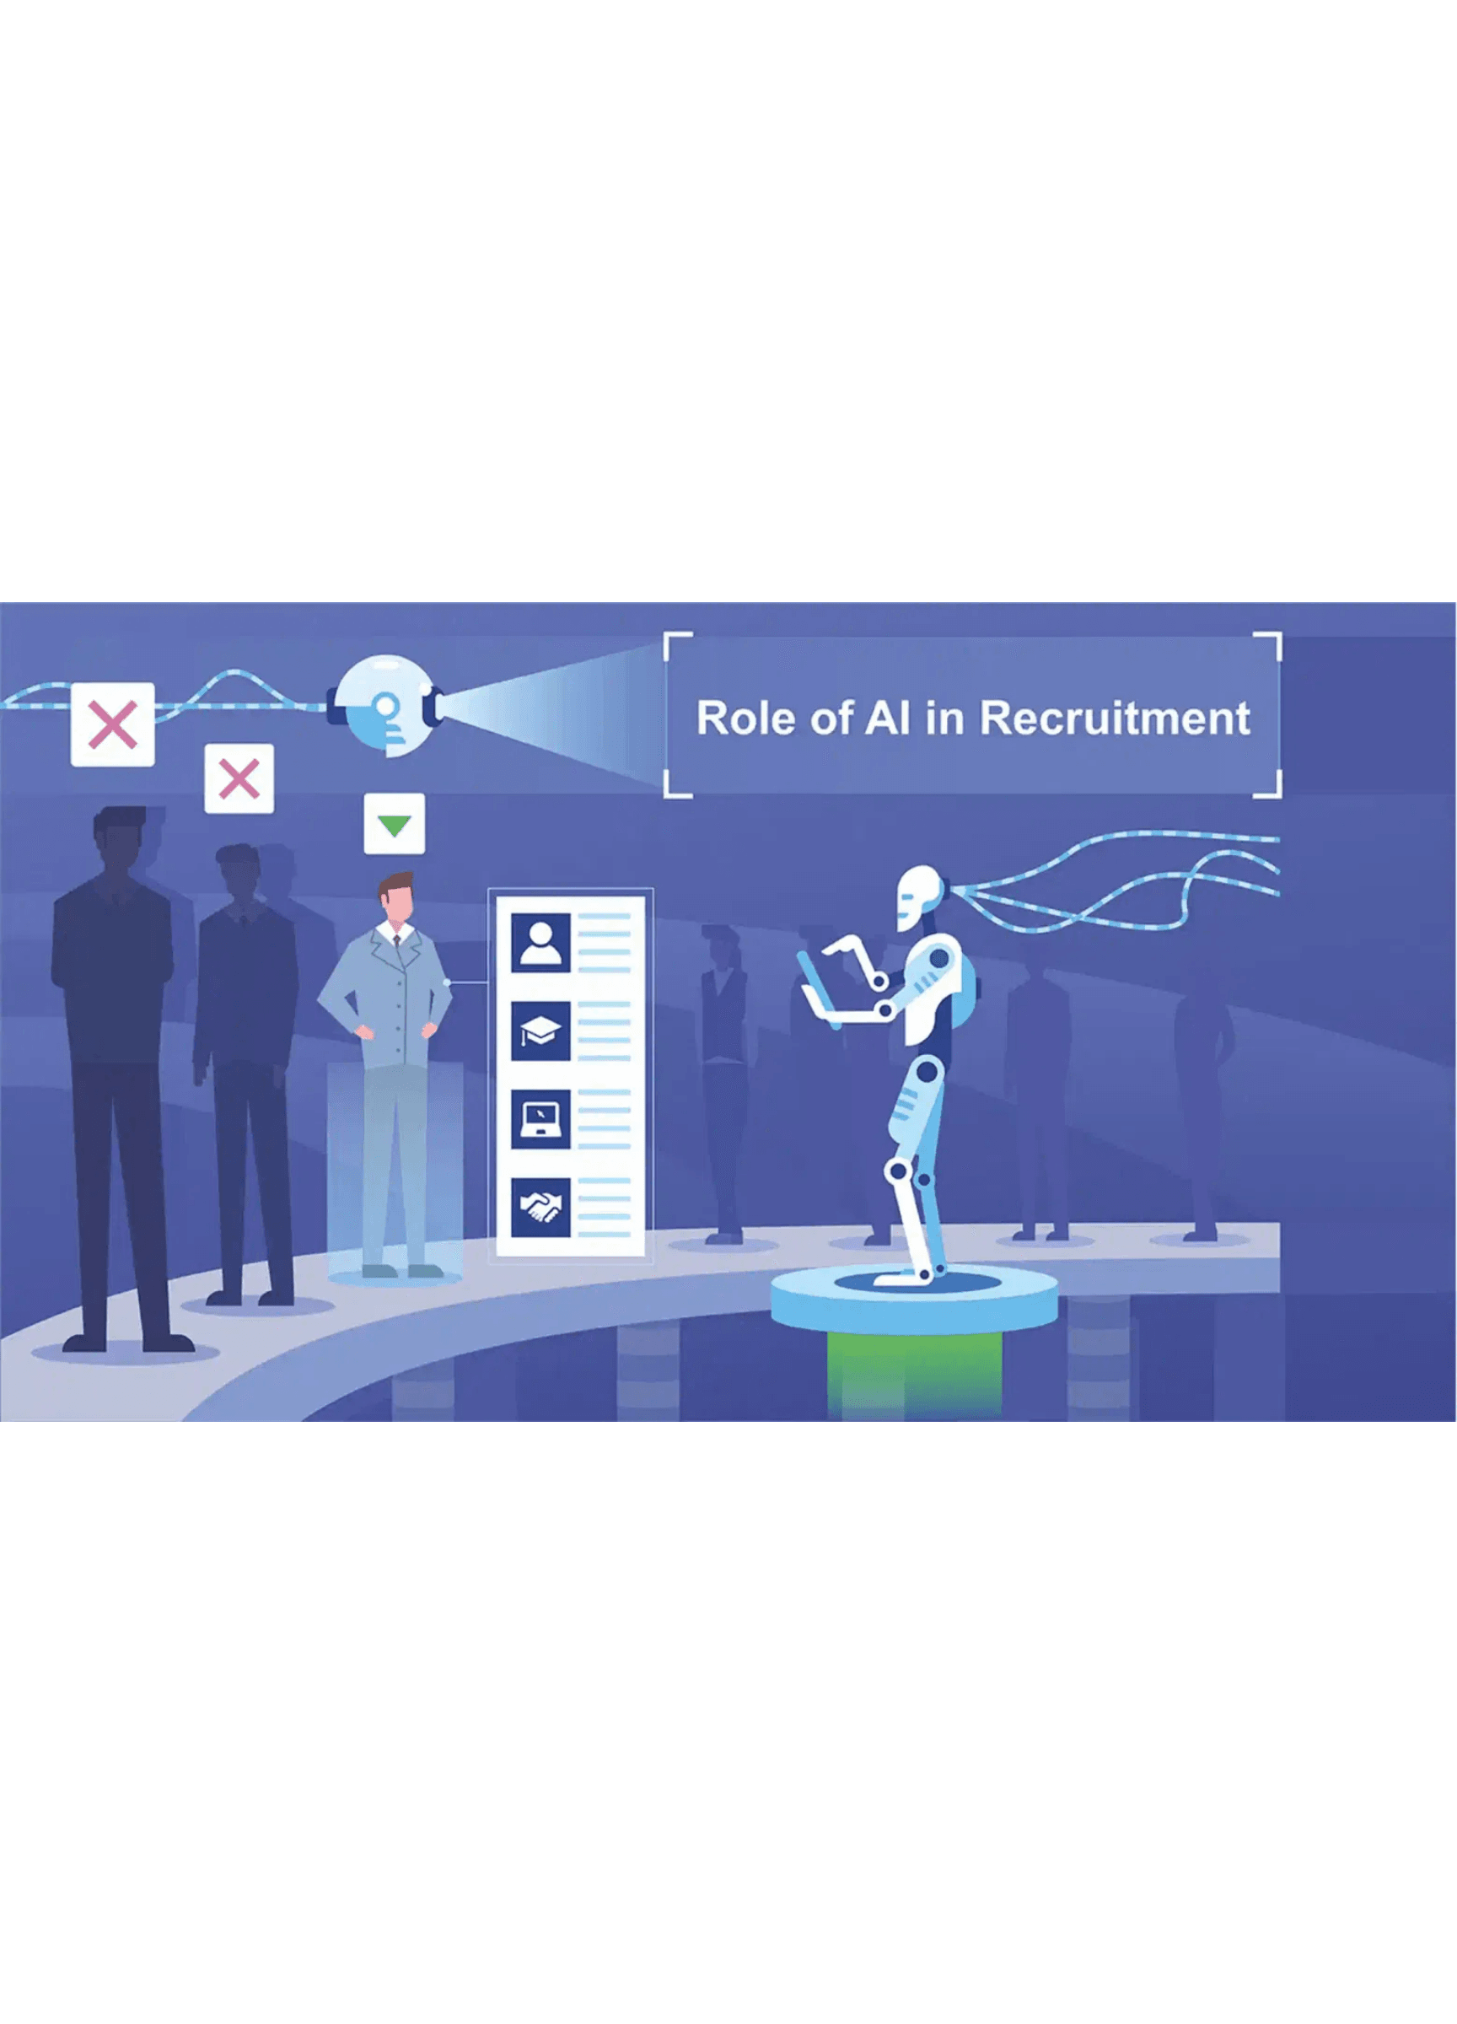

MATCHIFY
AI-Powered Recruitment Platform
Dr. Ammar Mohanna
EECE 503P – Agentic Systems
Team
Mounir Khalil
Haidar Yasine
Hassan Khalil

Slide 2





THE PROBLEM
The Recruitment Efficiency Crisis
Bad hires cost ≈30% of first-year salary
$5,475 avg cost-per-hire (U.S., non-exec)
7.2M job openings vs 7.6M unemployed (U.S., 2025)
Sources: Industry benchmarks from SHRM, U.S. Department of Labor estimates, and U.S. Bureau of Labor Statistics (BLS) labor market data.

Slide 3
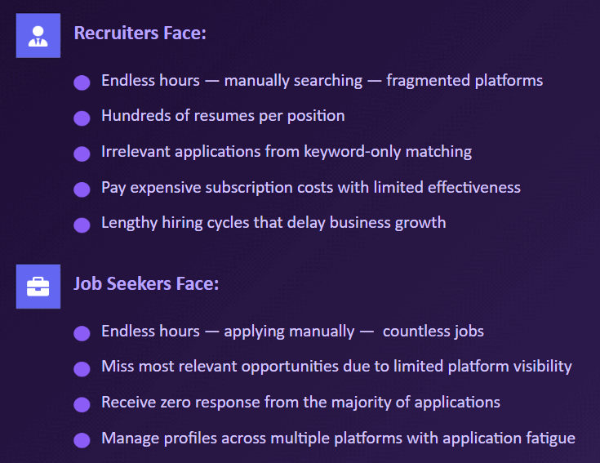



THE PROBLEM
The Recruitment Efficiency Crisis
Recruiters Face:
Endless hours — manually searching — fragmented platforms
Hundreds of resumes per position
Irrelevant applications from keyword-only matching
Pay expensive subscription costs with limited effectiveness
Lengthy hiring cycles that delay business growth
Job Seekers Face:
Endless hours — applying manually — countless jobs
Miss most relevant opportunities due to limited platform visibility
Receive zero response from the majority of applications
Manage profiles across multiple platforms with application fatigue

Slide 4
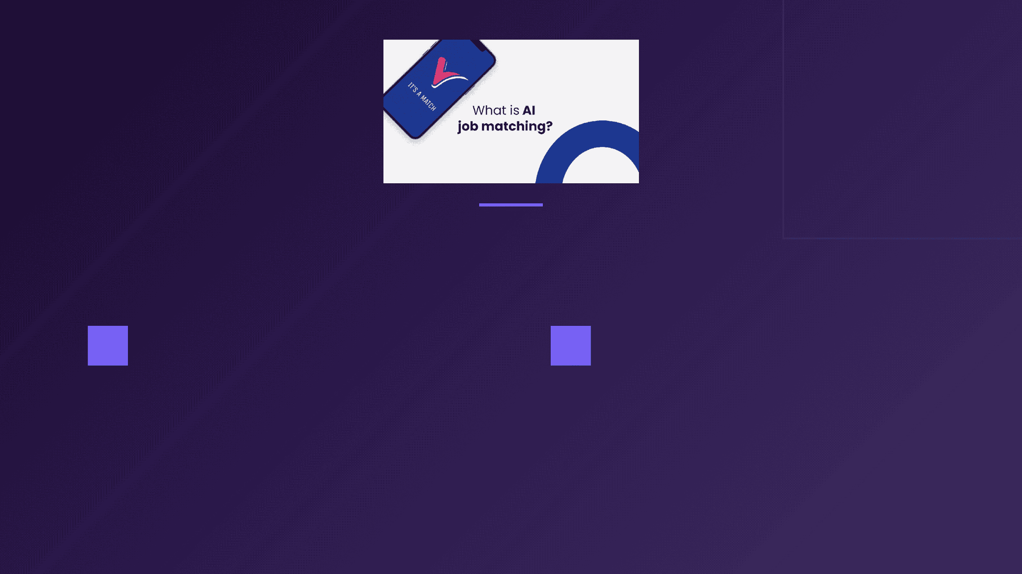
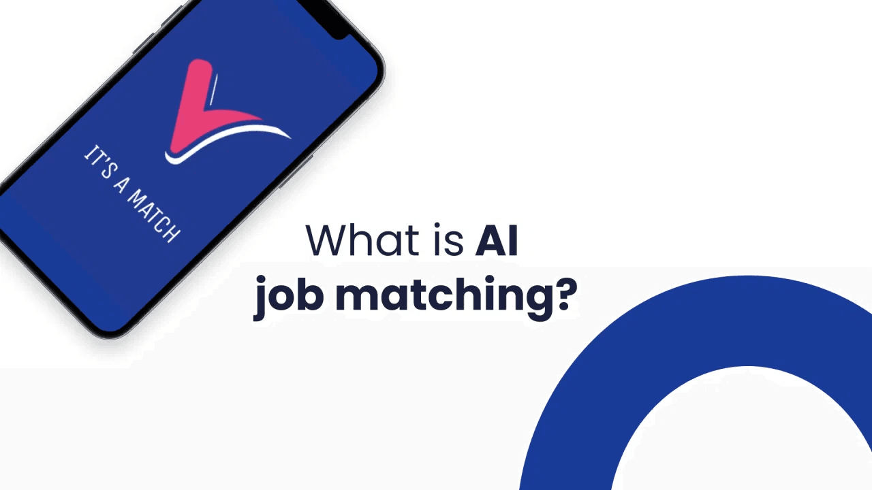








THE SOLUTION - MATCHIFY
Autonomous AI Agents for Intelligent Job Matching
For Job Seekers
For Recruiters
We automate the entire job search—from building your profile to finding opportunities and applying on your behalf. Set preferences once, and let AI work 24/7 on your behalf.
Discover and match top candidates across platforms. Our AI searches multiple sources for hidden talent. Post jobs, manage pipelines, and evaluate candidates in one place.
AI-powered profile building
24/7 automated job matching
Multi-platform candidate discovery
Auto-apply while you sleep
Intelligent AI-powered matching
Unified candidate management

Slide 5




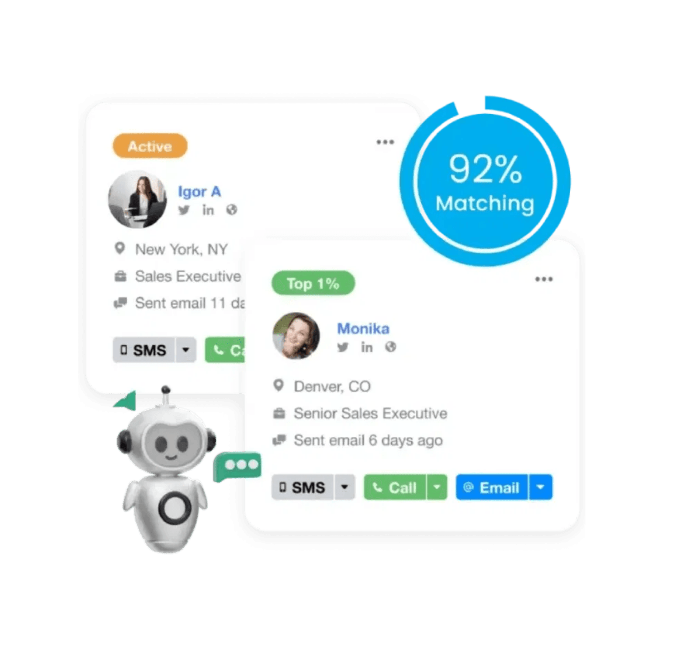




BENEFITS & FEATURES FOR JOB SEEKERS (1/3)
Instant Extraction
AI-Powered
Saves Hours
Automated Job Matching That Works While You Sleep
ProfilePal AI Assistant
Interactive chatbot that allows you to fill your profile through natural conversation instead of form-filling and guides you to complete missing information effortlessly. Upload your CV and it extracts everything automatically
Key Capabilities
Upload CV → AI extracts everything automatically
Conversational profile building through natural chat
Guides you to complete missing information effortlessly
Notes:
The third benefit for the job seekers is the ProfilePal Assistant

Slide 6

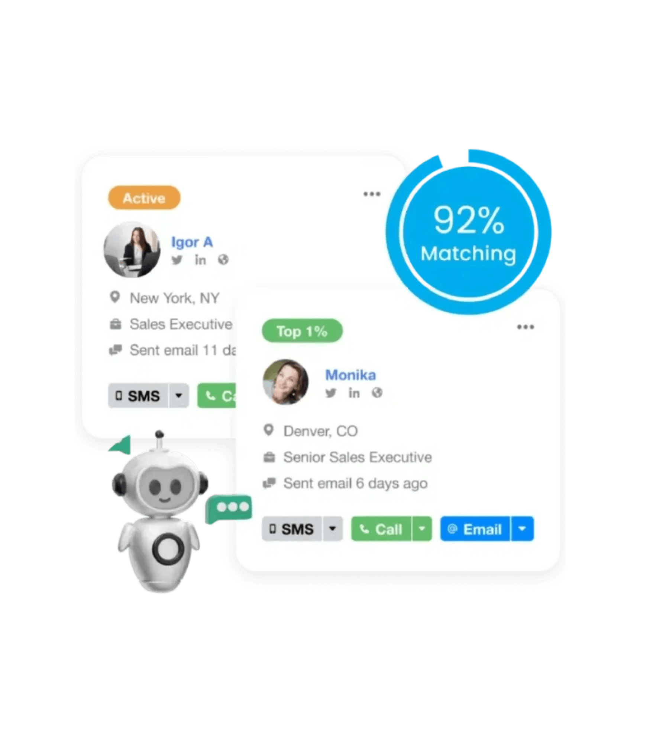


BENEFITS & FEATURES FOR JOB SEEKERS (2/3)
Automated Job Matching That Works While You Sleep
Auto-Apply Agent
Autonomous background worker that runs daily at 2 AM UTC to automatically match you with relevant jobs and submit applications on your behalf. It tailors your CV to each position and sends email notifications about matches.
Runs daily at 2 AM UTC while you sleep
Semantic matching finds jobs based on meaning, not just keywords
Tailors your CV to each job automatically for better fit
Email notifications alert you of matches and applications
Optional pre-approval notification (get notified before applying if you want)
5 applications/day max (prevents spam, maintains quality)
Notes:
The second benefit for job seekers is the Auto-Apply Agent. This agent works overnight in the background to automatically match candidates with relevant job opportunities.
First, it uses semantic matching to find roles based on meaning rather than keywords. Next, it tailors the candidate’s CV for each job. After that, it notifies the user about the matched jobs and submitted applications.
Users can choose whether they want to approve each application before submission or allow the agent to submit automatically. Finally, the agent applies to up to 5 jobs per day.

Slide 7
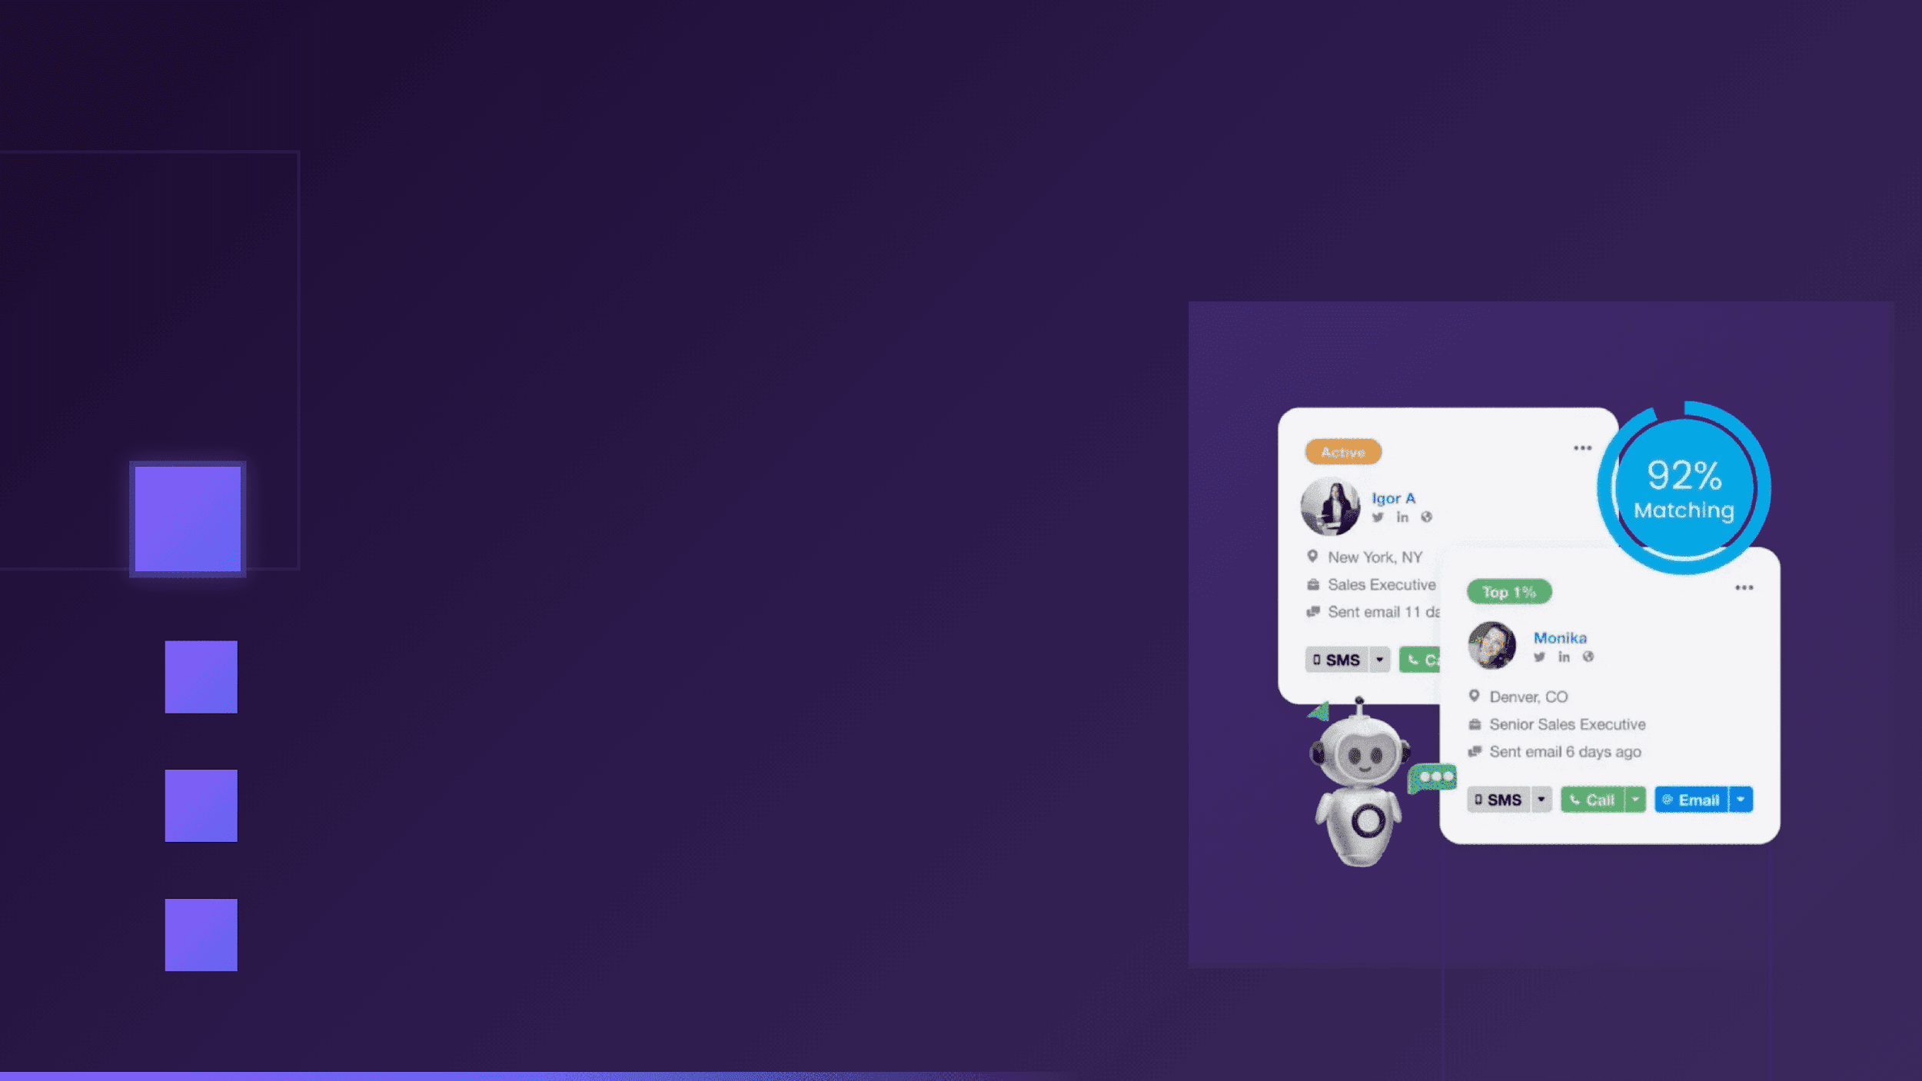








BENEFITS & FEATURES FOR JOB SEEKERS (3/3)
Full Control
Easy to Use
Track Everything
Automated Job Matching That Works While You Sleep
Additional Features
Manual Application Option
Browse and apply manually anytime with full control
Very Friendly User Interface
Seamless, intuitive design for effortless navigation
Application Tracking Dashboard
See all your applications in one place
Notes:
Also there will be additional features for job seekers like the manual application option, very friendly user interface, application tracking dashboard

Slide 8




















BENEFITS & FEATURES FOR RECRUITERS (1/3)
LinkedIn
GitHub
Google
StackOverflow
Headhunting Agent
30-50
<30s
4+
Candidates
Time
Platforms
Multi-source scraper that searches across LinkedIn, GitHub, StackOverflow, Google, and Twitter simultaneously to discover passive candidates. It searches for profiles, scores them intelligently, and finds email addresses for top candidates—all while securely managing your API keys.
Headhunting Agent Process Flow
Step 1
Step 2
Step 3
Step 4
Step 5
Step 6
Query Input
Parallel Scraping
Deduplication
Scoring
Email Discovery
Results
Job requirements & criteria
Multi-platform search
Remove duplicate profiles
Intelligent ranking
Find contact info
Ranked candidates
LinkedIn
GitHub
Google
StackOverflow

Slide 9

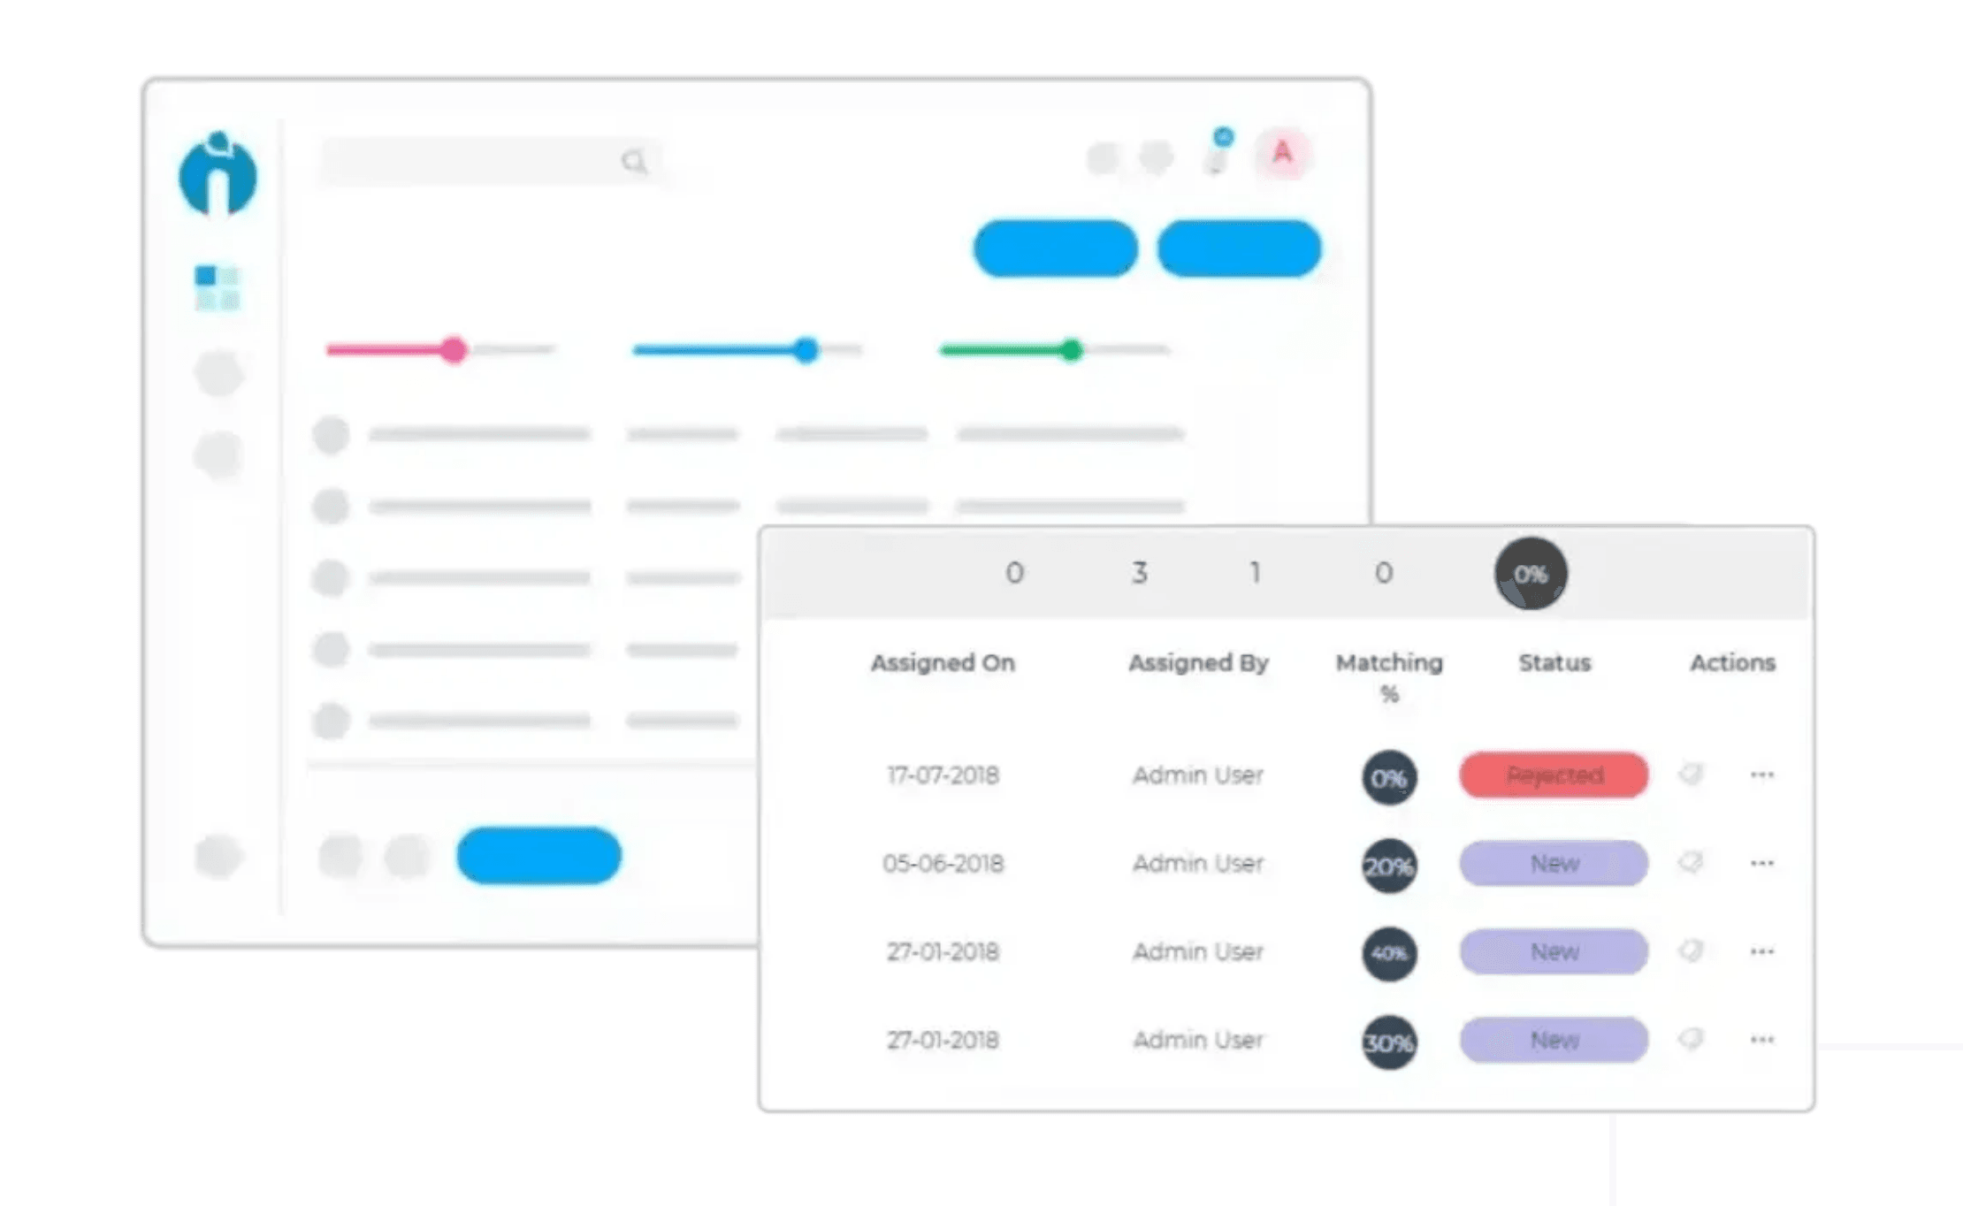










BENEFITS & FEATURES FOR RECRUITERS (2/3)
ReAct Recruiter Chatbot
Intelligent reasoning agent that understands complex natural language queries and autonomously decides which search strategies to use. It thinks through problems step-by-step, chooses the best tools dynamically, and adapts its approach based on intermediate results.
Key Capabilities
Natural language interface to find candidates from your collections
Autonomous planning: Decides whether to search internally first, then externally if needed
Multi-step reasoning: Chains multiple tools (semantic search → external search → filtering)
ReAct Agent Process Flow
Step 1
Step 2
Step 3
Step 4
Step 5
Query Input
Reasoning
Tool Selection
Execution
Results
User asks in natural language
Agent analyzes & plans strategy
Chooses search method dynamically
Performs search & retrieval
Returns ranked candidates

Slide 10

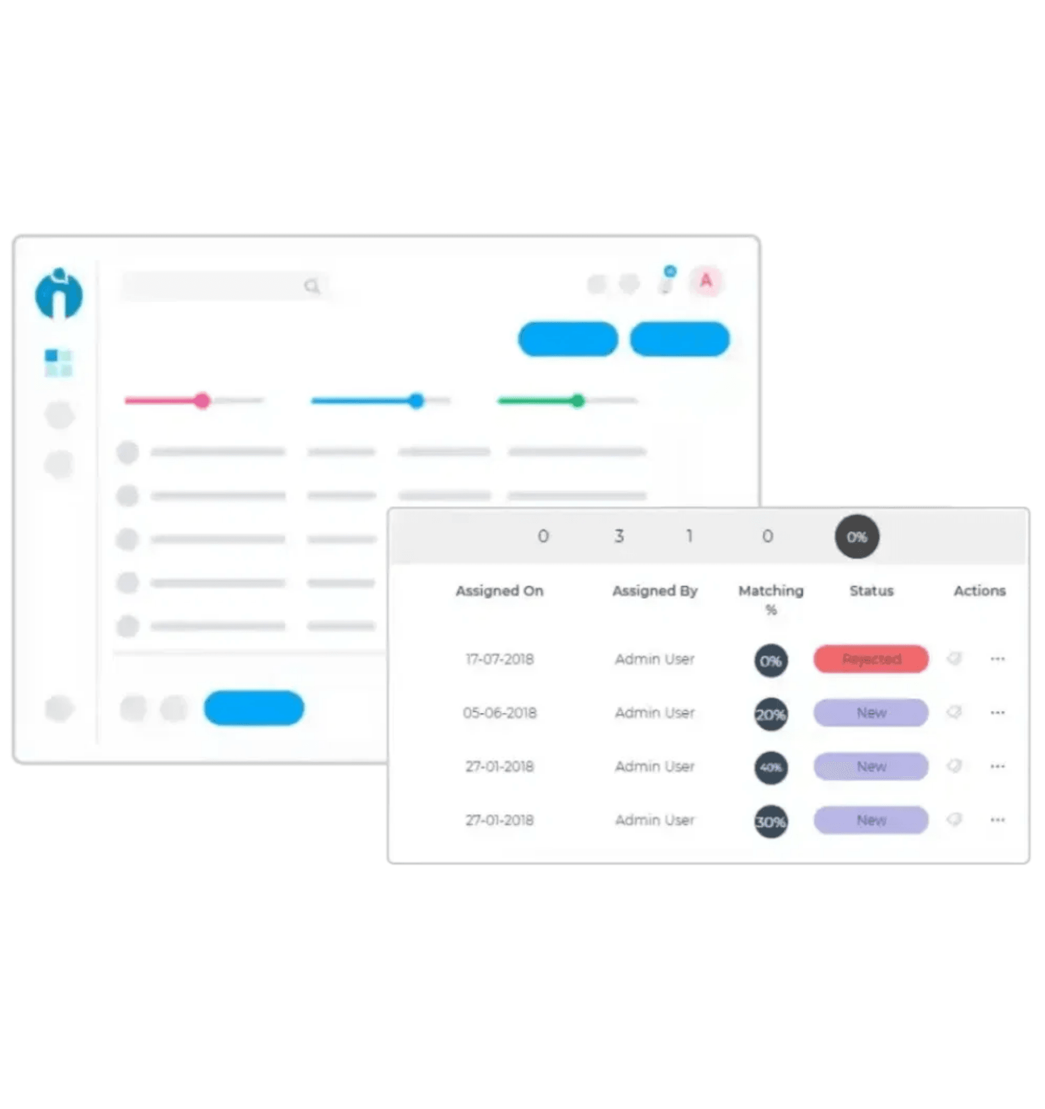





BENEFITS & FEATURES FOR RECRUITERS (3/3)
Smart Candidate Management
Very friendly user interface to review candidates
Unified inbox for all applications
Match scores + reasoning for each candidate

Slide 11







AGENT ARCHITECTURE DEEP DIVE
How the AI Agents Work Under the Hood
1
ProfilePaI Agent
LLM: GPT-4 Turbo with structured JSON extraction Tools: CV parsing, profile updates, improvement suggestions, embedding generation Performance: 2–4s latency, $0.01–$0.02 per conversation
2
Auto-Apply Agent
Trigger:
Cron job at 2 AM UTC daily
Workflow:
1. Generate candidate embedding
2. Vector search jobs
3. Hybrid scoring (AI+rules)
4. Tailor CV to job
5. Email notifications
6. Safety checks
7. Submit + notify
3
ReAct Recruiter Agent
RAG-based retrieval: Embeddings + vector search; LLM ranks/explains True autonomous planning: GPT-4 selects tools and order
4
Headhunting Agent (Deep Dive)
API Integration System: BYO API keys (encrypted). Providers: GitHub (free), LinkedIn via Proxycurl/Apify/Phantombuster, etc. Pipeline: Query → parallel search → merge → score → find emails → save to DB Platform Strategies: LinkedIn (title, location, skills); GitHub (lang, topics, bio); Google/SerpAPI; StackOverflow (tags, rep)

Slide 12







FUTURE WORK
Vision for Expansion
Beyond Jobs: University Applications
Expand to automate university and graduate program applications
Match students with academic programs based on interests and background
Broader Reach
Expand to additional platforms and data sources
Integrate with more job boards and professional networks

Slide 13

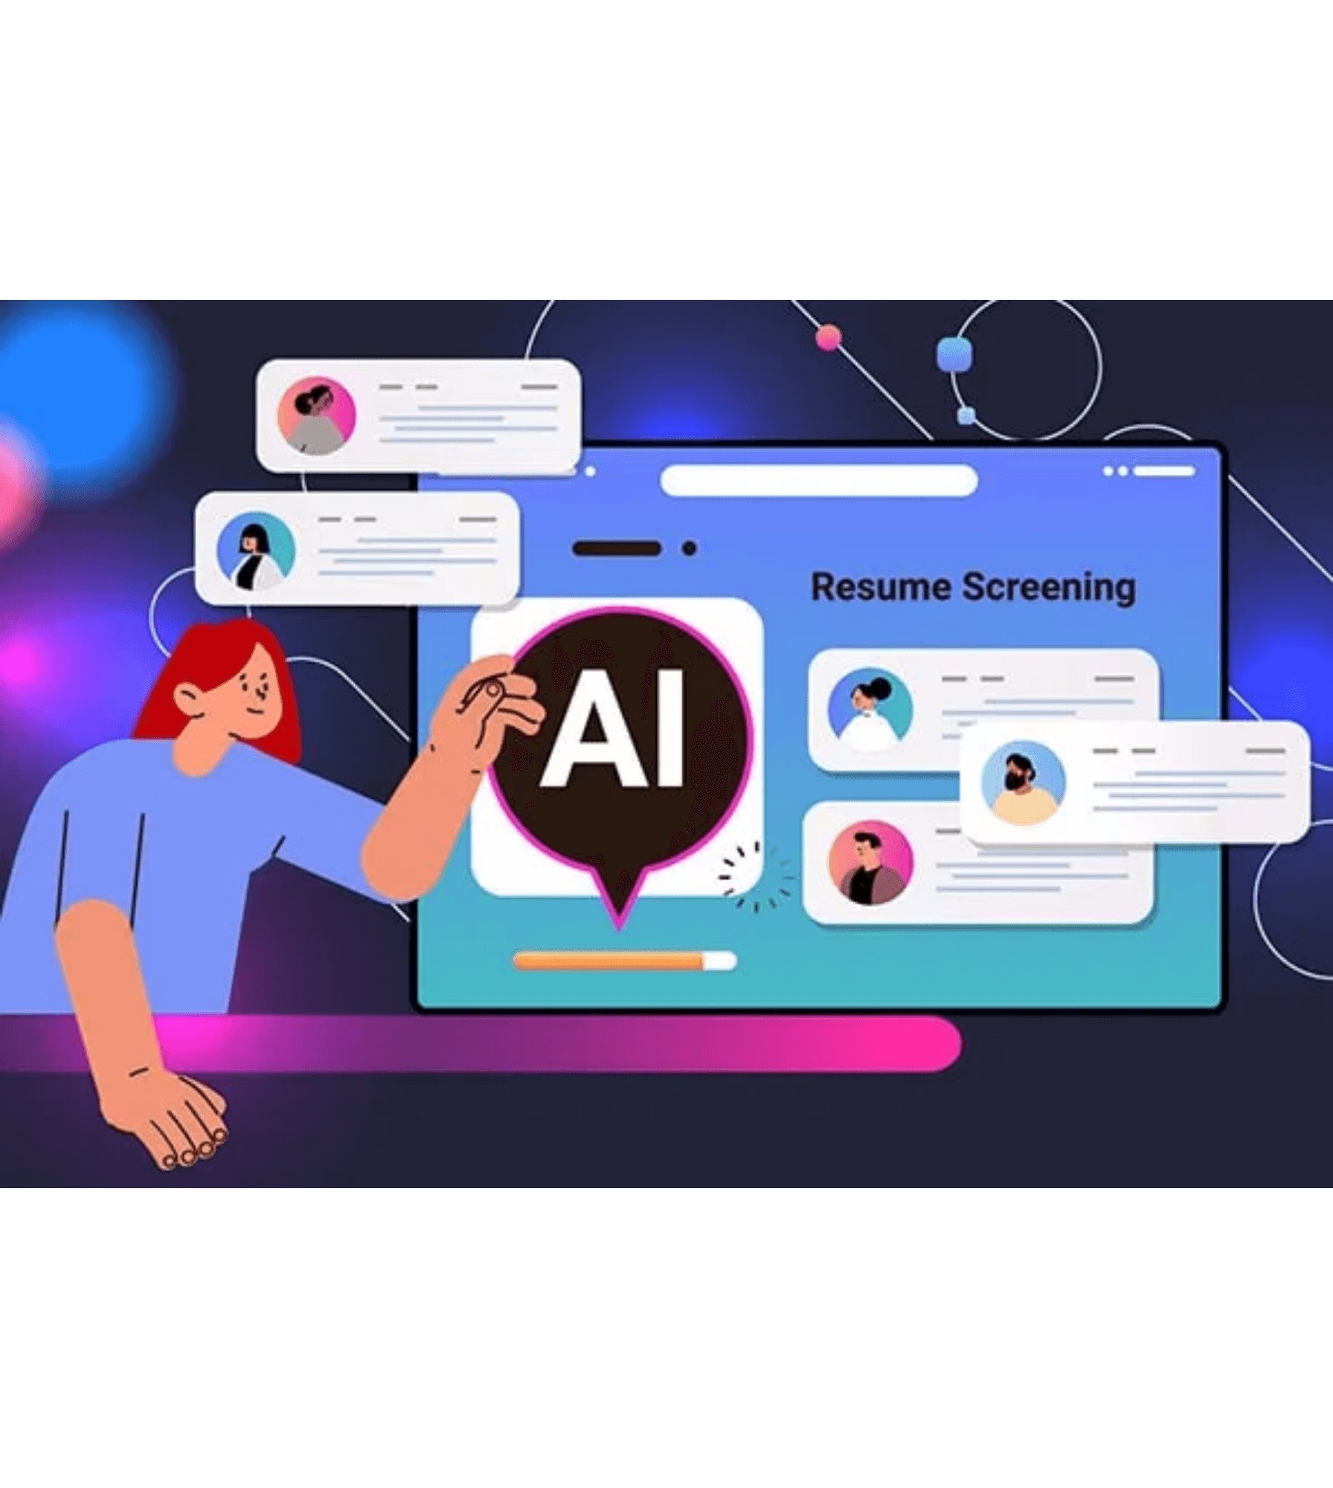



SAFETY & ETHICS
Multi-Layered Defense - Production-Grade Security
AI Safety
Implemented 18+ prompt injection defenses (100% detection rate in pilot)
Output sanitization to redact API keys and secrets
Rate limiting: 5 applications/day max, 5 agent iterations max
User Control & Transparency
CV review system: Users can view and approve tailored CVs before application
Explicit opt-in required for auto-apply (checkbox consent)

Slide 14




THANK YOU
& DEMO
Try It Live
matchify.live
Team
Mounir Khalil
Haidar Yassine
Hassan Khalil
EECE 503P – Agentic Systems

